Slide 1
Secure IoT Home Gateway & Home Registry – Idea & vision Open standards development
Jacques Latour, CTO Canadian Internet Registration Authority February 15, 2018

Slide 2
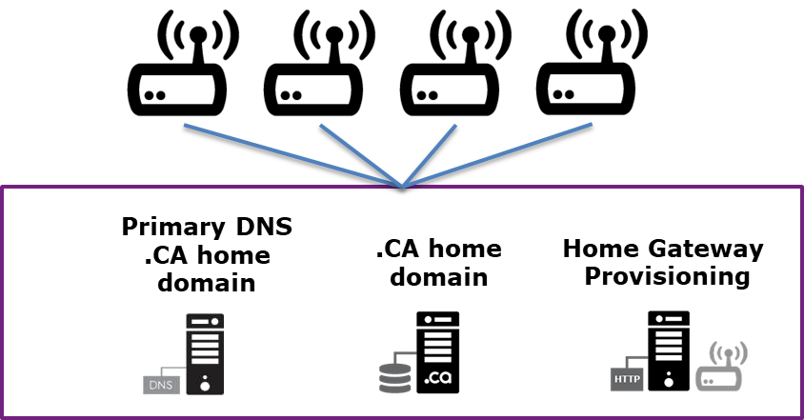

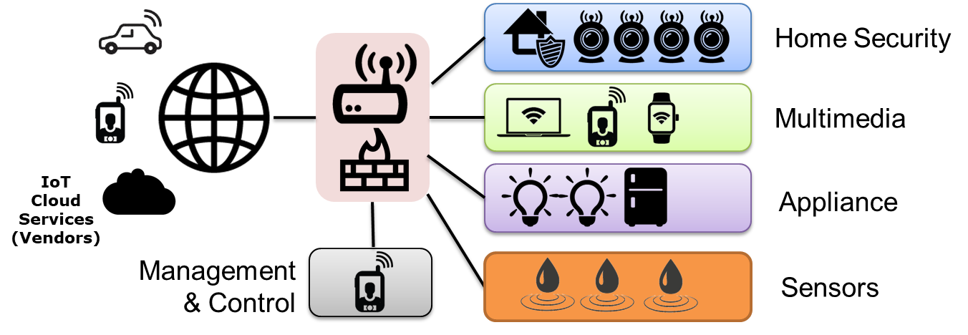
2 distinct ideas into one solution
IDEA #1 – ccTLD Home Registry
Value Proposition:
For ccTLD, to have a domain per household
Leverage the DNSSEC chain of trust by having a registered domain for home use
.CA Home Registry
IDEA #2 – Secure Gateway
Value Proposition:
To create a security framework to protect the Internet from IoT device attacks
To enhance the home network privacy & security with network access controls
IoT Secure Home Gateway

Slide 3
Secure Home Gateway & Registry Idea
For many internet organizations, the #1 risk on their risk register is a large scale (Dyn like) DDoS attack. One of the mitigation mechanisms for this risk is to prevent weaponization of IoT devices
Protecting IoT devices at the edge is another layer of security that should be further developed
The security controls would be aimed at protecting the IoT devices from the internet, and to protect the internet from IoT devices.
The threat that IoT devices bring is scale. The scale of million and billions of IoT device is the threat we need to mitigate.

Slide 4
IoT Threat landscape SPECIFIC TO THE INTERNET - SCALE
IoT device compromises:
Used in internet attacks i.e. MIRAI/DYN Attack (DDoS) targeting DNS servers (1.2 Tbs)
IoT traffic reflection and amplification
IoT device used to amplification traffic attack (DDoS) NTP, DNS, SNMP.
The scale of IoT threat landscape and the breath of exploits is what need to mitigated
IoT devices must not have wide open internet access (protected by firewall)
Inbound and outbound internet access must be controlled

Slide 5

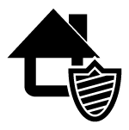












How can we protect IoT devices?
Control inbound and outbound network access
Rule 1: Place behind firewall
Rule 2: Segment network by IoT type
Rule 3: Control access to and from the IoT device
Home Security
Multimedia
x
Appliance
IoT Cloud
Services
Sensors
Management

Slide 6

Today’s Home Network & IoT implementation are disparate, kind of scary & IN need OF structure!
Notes:
http://www.istockphoto.com/ca/photo/internet-of-things-concept-with-network-of-connected-objects-gm644680544-116869175

Slide 7

The home network of the future must be safe, secure and simple to use!
Notes:
http://www.istockphoto.com/ca/photo/circular-futuristic-interface-of-smart-home-automation-assistant-virtual-screen-gm637770524-113940363

Slide 8

The home network must be reachable from the internet seamlessly and securely
Notes:
http://www.istockphoto.com/ca/photo/businessman-touching-a-cloud-connected-to-objects-internet-of-things-gm514785054-88267551

Slide 9
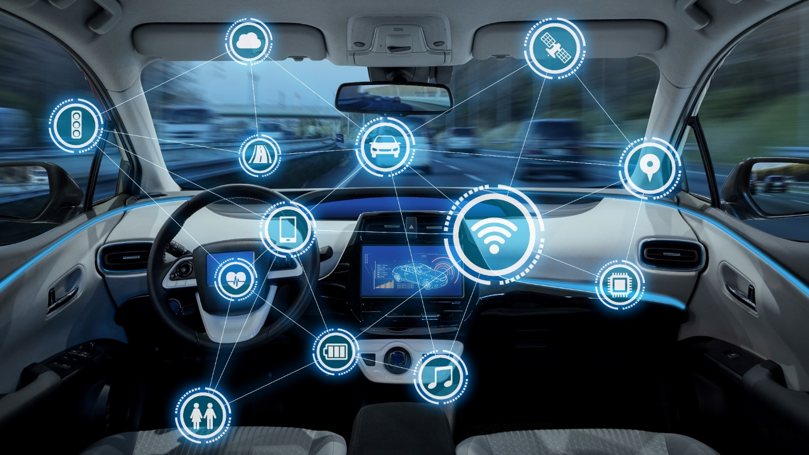
even your car WILL be connected to your home network
because your home is bigger than your house
Notes:
http://www.istockphoto.com/ca/photo/intelligent-vehicle-cockpit-and-wireless-communication-network-concept-gm692837788-127932641

Slide 10

The home network grows to include personal and wearable IoT, inside and outside the home…
because eventually they will be IPv6 enabled
Notes:
http://www.istockphoto.com/ca/photo/man-wearing-vr-headset-gm583697902-99848893

Slide 11


Your home network security both internal and external must be protected using a common key
Notes:
http://www.istockphoto.com/ca/photo/smart-phone-remote-for-smart-home-hologram-technology-concept-gm839028202-137738281

Slide 12

Leveraging the chain of trust in DNSSEC and some innovation to create a secure home network platform
Notes:
http://www.istockphoto.com/ca/photo/digital-handshake-on-blue-background-gm613033814-105721913

Slide 13

Do WE need to say more?
Public service announcement: We’re out of IPv4 addresses !!!
Notes:
http://www.istockphoto.com/ca/photo/ipv6-new-internet-protocol-gm502837022-82158325

Slide 14






what does this bring to the ccTLD domain industry?
myhome.ca
myhome.net.ca
IoT
Cloud
services
A domain name per household!!!
Notes:
http://www.istockphoto.com/ca/photo/home-computer-network-gm98265636-7381753
Need new picture, looks ugly ;-)

Slide 15

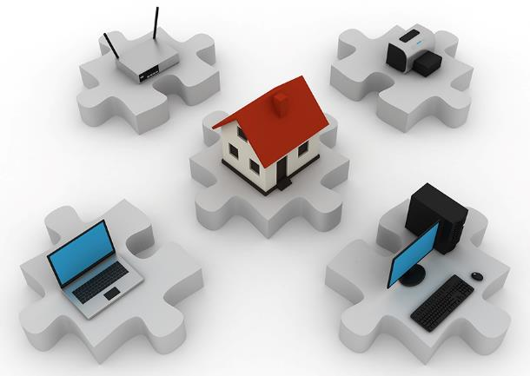
The focus is on AutomatioN
Registry
Automation
Home Network
Automation
+
Innovation
Notes:
http://www.istockphoto.com/ca/photo/home-network-gm117311543-7381629

Slide 16

Your local ccTLD will provision your DNSSEC signed domain internally on your gateway and externally on the Internet, and establish a secure chain of trust to your home gateway, magically solving all your worries and keeping your family safe ☺
Notes:
http://www.istockphoto.com/ca/photo/young-girl-looking-up-at-a-stereoscopic-vision-of-the-earth-internet-of-things-gm690778240-127332717

Slide 17
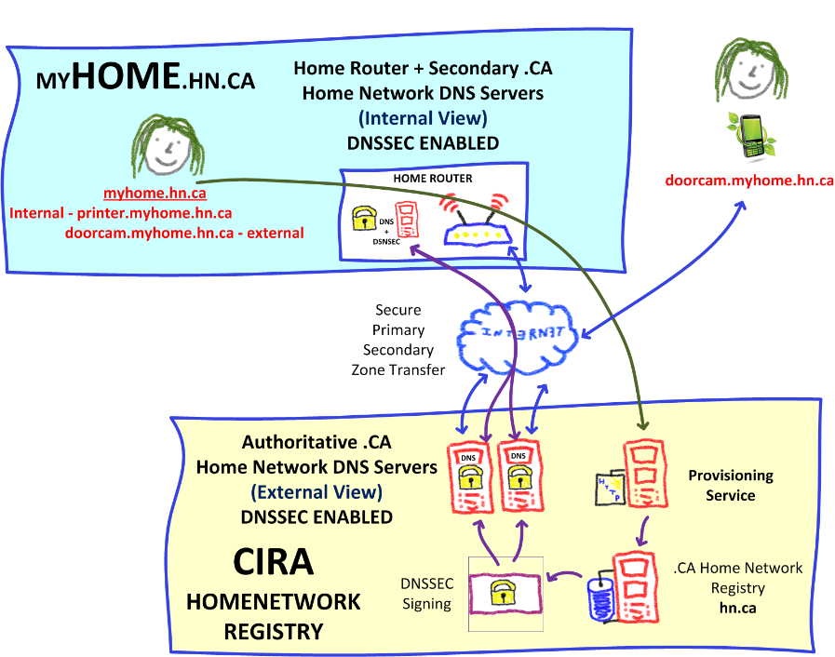
Remember, it’s an idea & vision! Get ready for the story ☺
That’s
a napkin
design
☺

Slide 18

Step 1
When you buy a home gateway, it comes bundled with a .CA home network domain
+
A 2nd or 3rd level domain
i.e. myhome.net.ca
i.e. myhome.ca
RFID card
(Code to activate provisioning and domain)

Slide 19



Step 2
Then you follow the provisioning instructions
Install & open the CIRA Home Gateway app
Turn on the Home Gateway
“TAP” your mobile to discover the home gateway
Pick a domain name, 2nd or 3rd level domain name
Enter the secret code (“TAP” RFID card)
Home Gateway ready for configuration
+
myhome.ca code

Slide 20

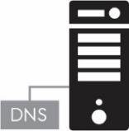
Step 3
Automated Backend Provisioning @ CIRA
CIRA creates the .CA domain name in the registry
CIRA signs the .CA domain with DNSSEC
CIRA is primary for the external DNS view of the .CA domain
CIRA provides secondary DNS to the .CA domain
+
+
.CA
Registry
EXTERNAL
(Internet)
DNSSEC
(Keys)

Slide 21

Step 4 (NEEDs WORK)
Automated Home Gateway provisioning
Establish secure connection to Home Gateway
Securely send private DNSSEC key to Home Gateway, setup internal DNS and DNSSEC
Configure Home Gateway for DNS integration with registry (à la dynamic DNS) for external services
+
+
←→
DNSSEC
(Keys)
EXTERNAL
(Internet)
INTERNAL
(Home Network)
Dynamic DNS

Slide 22


Step 5
Setup secure home network infrastructure
Using your trusted mobile & the app, “TAP” the Home Gateway to:
Learn the WIFI password
Get the IPSec password, SSO tokens and keys to VPN in your home network
Use your mobile and “TAP” all your IoT devices to add on your home WIFI network, easy peasy ☺

Slide 23
At this point we have
A home gateway fully provisioned with a .CA domain name, with both internal and external domain name resolution, signed with DNSSEC.
WIFI and other networks securely provisioned and setup
Now we’re ready to provision the IoT devices
fridge.la-house-a-latour.ca Internal IP
printer.la-house-a-latour.ca Internal IP
Internal domain fully operational
Secured internally by DNSSEC
External domain to allow exposing internal services and make them available externally
vpn.la-house-a-latour.ca External IP

Slide 24
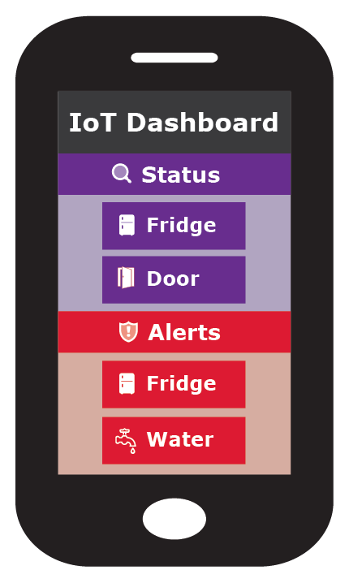
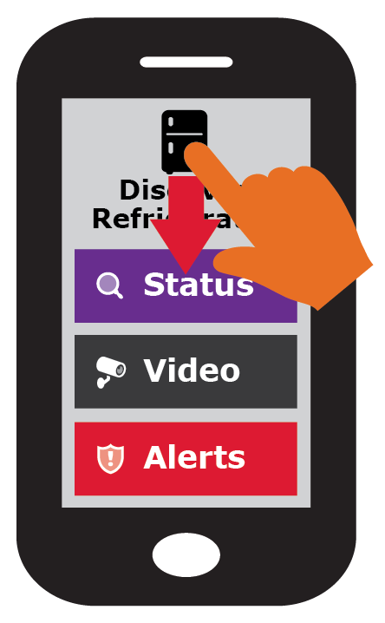
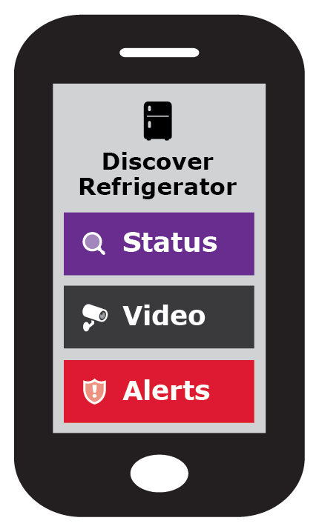






Now, let’s see how we provision IoT DEVICES IN HOME NETWORK
Once the IoT device has network access TAP to discover
IoT device exposes via RFID (or similar) the services available
Pick relevant IoT services category fro provisioning
Expose Services
JSON blob / RFID

Slide 25



adding remote vpn access to trusted mobile
Mobile
(2) Grant permission and credentials to mobile for remote home access
(1) Tap the mobile
Discover services

Slide 26



Adding your Car to remote access your home network
Car
(2) Assign roles
Control car feature
View car alerts
(1) Tap the car
Discover services
View car status/location
Grant permission and credentials to car mobile for remote home access

Slide 27








IoT Service / action type
Status: Up/down, on/off, ok/bad, status variable
Audio/Video: Camera, video feed
Media: Audio/Video media feed, TV, music
Storage: Data storage, NAS (pictures, files, data)
Alerts: Up/down, on/off, ok/bad, “Water detected”
Control: Turn up/down, on/off, change device value
Cloud Service: IoT vendor, Google, MS, DropBox
VPN (VPN inside myhouse.ca)
Remote house access
Other Sensors/ Actuator functions?

Slide 28

TODO: Scenario: Adding a smart TV
WORK IN PROGRESS

Slide 29
TODO: + ADD Scenarios FOR each device type
TODO: as part of the functional specification documentation.
Example of pushing WIFI to the device
show that the fridge is exposing service
And ready to receive services {WIFI}
No web interface on IoT device
Focus on cloud / vendor, show they integrate into this solution, can be multi vendor multi cloud provides

Slide 30
Your home network security is compromised?
Get the ccTLD to perform an emergency DNSSEC key roll over, externally and on the home gateway
Will have new keys on home gateway
This will make all VPN keys & certificate invalid
A roll over will force the generation of new keys.
Trusted “management” home gateway mobile access must be re-established using an out of band token
Remote home access trust must be re-established
Local network access controls should remain the same

Slide 31

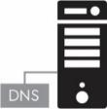

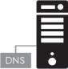
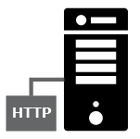

High Level SOLUTION Architecture
Internet Home Network Trust
OpenWrt
Home Gateway
Internal DNS/DNSSEC
External IPSEC
D-Zone firewall
Wifi MiFi Zigbee
NFC RFID
myhome.ca
Remote Home Network Access
(VPN IPSec)
IoT Cloud
Services
(D-Zone Firewall)
Home Network Registry
Primary DNS
.CA home domain
.CA home domain
Home Gateway
Provisioning
IPv6 ONLY
☺

Slide 32

What do you think?
Want to help?

Slide 33
Going forward, it’s a journey! ccTLD Value proposition
Motivation
Ensure long term ccTLD relevance in the future of IoT
To create a secure <internet home> IoT environment
Proposing ccTLD to develop a solution
To keep the home network safe and secure
To leverage DNSSEC as an innovation platform to create a hub for “home trust”
That leverages the ccTLD registry expertise
To enhance OpenWRT with this functionality

Slide 34
Next Steps – build a PRototype
Develop a Proof of Concept and prototype
Using .CZ Omnia Home Gateway (openWRT)
Home Gateway App (Android/iPhone)
Develop some IoT discoverable devices (RFID)
Use public GitHub to document the functional specification and repo for prototype software
Functional specification
Software repository

Slide 35
This slide deck is a vision it’s what we’ll be using In 5 years
Is work in progress, presented as a story
Story how a home gateway can be IoT friendly and how a ccTLD registry provision a secure domain per household
Is meant to define a security framework and associated standards
IETF, ISO/IEC, others..
Is tuned around implementation at .CA / CIRA, but not specific just for CIRA
Is to solicit feedback
Is another layer of defence in depth to protect the internet

Slide 36

Your new <Internet Home>
https://github.com/CIRALabs/Secure-IoT-Home-Gateway
Whatch the github project
to get update notifications

Slide 37
home.arpa. draft-ietf-homenet-dot-14
IETF working on making the default home network address: [yourprinter.]home.arpa.
<<The naming mechanism needs to function without configuration from the user. While it may be possible for a name to be delegated by an ISP, homenets must also function in the absence of such a delegation.>>
Let’s make delegated “home” domains function without user configuration!

Slide 38
Solution: Network Access control (NAC) & default security controls
Something like ; packetfence on openwrt
Example of default zone security controls / policies
Home Security -> may have access to cloud
Emergency services may have access
Sensors -> no access to internet
Apppliances may have access this zone
Appliance -> no access to internet
VPN may have access this zone
Allow myhome.ca to access myparents.ca
Only for Home Security and sensors

